Slide 1
Systems Design and Security
Part 1: Software Engineering
http://staffwww.dcs.shef.ac.uk/people/A.Simons/
Home ⇒ Teaching ⇒ Lectures ⇒ COM2008/COM3008

Slide 2

Bibliography
Software Engineering
I Sommerville, Software Engineering, 10th ed., Pearson, 2016.
R S Pressman and B R Maxim, Software Engineering: A Practitioner's Approach, 9th ed., McGraw-Hill, 2019.

Slide 3
Outline
Software engineering definitions
History of software engineering
Famous myths and software failures
Software lifecycle activities
Traditional software process models
Radical software process models
Software component-based industry
Reading: Sommerville chapters 1-3, 16 Pressman chapters 2-4

Slide 4
What’s the Difference?
Computer Science
develops theory, methods, limits of what is computable
algorithms, data structures, formal grammars, abstract machines, numerical analysis
Software Engineering
applies theory, methods to solve practical problems
creates complex software products
follows a design, management process
uses models of systems (diagrams, specifications)
deals with people (stakeholders, managers)

Slide 5
Software Engineering…
is the application of a systematic, disciplined, quantifiable approach to the development, operation and maintenance of software.
[IEEE Standard Glossary of Software Engineering Terminology, IEEE std 610.12, 1990]
is an engineering discipline that is concerned with all aspects of software production.
[I Sommerville, 2016]
is the establishment and use of sound engineering principles in order to economically obtain software that is reliable and works efficiently on real machines.
[F L Bauer, NATO Conf. Softw. Eng., Garmisch, 1968]

Slide 6
Some History…
NATO Conference, Garmisch, Germany, 1968
convened to discuss the “software crisis”
more complex systems on 3rd generation hardware
first coined the term “software engineering”
The software crisis
delays in software delivery
higher costs than originally estimated
software unreliable, difficult to maintain
Need for new methods
engineering discipline (apply theories within real constraints)
cover all aspects of production (technical and management)

Slide 7
Software Myths
Management myths
Follow published standards for building software
Use state of the art tools to build software
Add more programmers if behind schedule
Customer myths
General description of objectives is enough to start coding
Requirements may change as the software is flexible
Practitioner myths
Task is accomplished when the program works
Quality assessment only when the program is running
Working program is the only project deliverable
Continuing “software affliction” [Pressman, 1997].

Slide 8

Software Failures
Therac-25 (1985-1987): six people overexposed during treatments for cancer
Taurus (1993): London Stock Exchange automated transaction settlement system cancelled after 5 years in development
UK Passport Office (2006): project cancelled after 10 years, wasting £12m, wrecking 500 holidays; due to lack of testing and change control
[http://infotech.fanshawec.on.ca/gsantor/ Computing/FamousBugs.htm]

Slide 9
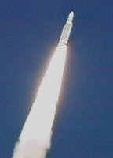
Technical Failures
Ariane 5 (1996): explodes 39 sec. into launch due to an error converting from floating point into 16-bit integer
Costs $7bn and 10 years of effort – carried the original Cluster satellite mission
Real cause: wrong assumption when reusing Ariane 4 guidance package
Click image for video

Slide 10
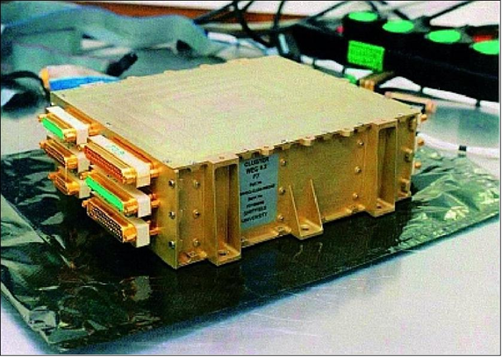
What we Lost!
Digital Wave Processor
DCS built a high reliability multiprocessor unit based on the INMOS Transputer with parallel processing and re-allocatable tasks. Controlled all scientific instruments for data compaction, compression, event selection, and particle/wave correlation.
© University of Sheffield

Slide 11
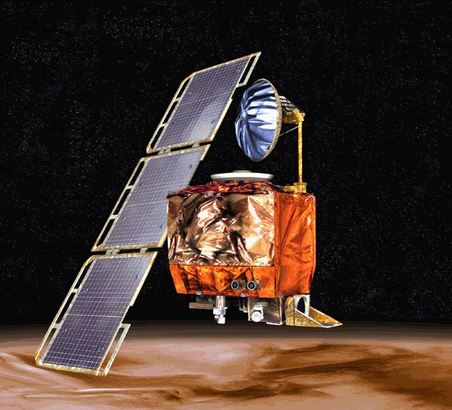
Systemic Failures
Mars Climate Orbiter (1999): lost by NASA flight controllers during orbital insertion
Different measurement units (imperial and metric) for guidance and propulsion
Real cause: lack of communication between software teams

Slide 12
Some Progress…
Increased ability to produce more complex software systems (modular, component-based)
Effective methods to specify, design, implement software have been developed (formal models, code generation)
A better understanding of the activities involved in software development (people issues – psychology, politics)
Novel software engineering approaches (clean room, time-boxed prototyping, test-first design)
Standard notations and tools have been produced (UML, CASE tools)

Slide 13
Lab 1: Software and Risk
Other famous failures?
Can you name recent interesting cases?
What dangers and risks are we running?
What main cause of failure? (rank 1-3)
weak developer skills/coding practices
poor team communication
poor project/risk management
What legal/social changes?
How will the profession of Software Engineer change?
Run a Poll

Slide 14
Kinds of Software
System software
Real-time software
Business software
Engineering and scientific software
Embedded software
Personal computer software
Web-based software
Artificial Intelligence software
Research software

Slide 15
Software is Everywhere
Business information systems
Banking, finance, purchasing, office data systems
Embedded systems
Internet, telecoms, medical, industrial processes
Lifestyle/entertainment
TV, video, film, games, publishing, social networks
Science and engineering
Genetics, robotics, education, military ...
Software is...
the most complex of any engineered human artifact

Slide 16
Software Process
A software process consists of a set of activities and associated results which lead to the production of a software product [Sommerville, 2016]
Four fundamental activities:
Software specification – requirements, formalisation
Software development – design, implementation
Software validation – validation, verification, testing
Software evolution – bug fixes, upgrades, adaptation
Software involves: Products – Processes – Models – People

Slide 17
Software Lifecycle
What kinds of activity?
Commission a software system
Feasibility study
Requirements elicitation
Construct the software system
Systems analysis, formal specification and design
Implementation, testing and deployment
Maintain the software system
Fix faults, extend the system
Decommission the system

Slide 18
Lifecycle Activities – I
Feasibility Study
Outline the objectives of the business
Met by the software system, or by other means?
Requirements Elicitation
Collect required system behaviours from stakeholders
Use interviews, workshops; get different viewpoints
Systems Analysis
Determine the scope, interface to other systems
Break down into models of: data, processing, time
Model what the system has to achieve (not how)

Slide 19
Lifecycle Activities – II
Formal Specification
Logical model and proof of expected behaviour
For safety-, mission-, business-critical systems
Systems Design
Split into units, modules and subsystems
Choose between alternative design strategies
Model how the system achieves its goals
Implementation
Select technology: programming language, web script
Construct units, modules and integrate the system

Slide 20
Lifecycle Activities – III
Testing
Unit testing, integration testing (up to specification)
Path coverage, stress-, load-testing (no failures)
Acceptance testing by users (up to requirements)
Deployment
Install, configure system (at multiple sites?)
Operate the system
Maintenance
Fix faults discovered late in the system
Add new functionality (new requirements)
Decommission the system (outlived its usefulness)

Slide 21
Software Process Models
Traditional software process models
Waterfall software lifecycle model [Royce, 1970]
Spiral software lifecycle model [Boehm, 1988]
V-model of the software lifecycle [Germany, 1996]
Formal software process models
Cleanroom [IBM]
VDM or Z/B with refinement
Radical software process models
Prototyping models (rapid- ; evolutionary-)
Time-boxed models (Rapid Appl. Dev., DSDM)
Agile methods (eXtreme Programming, Scrum)

Slide 22
Waterfall Lifecycle Model
Requirements analysis and definition
a linear lifecycle model
[Royce, 1970]
System and software design
Implementing and unit testing
Integration and system testing
Operation and maintenance

Slide 23
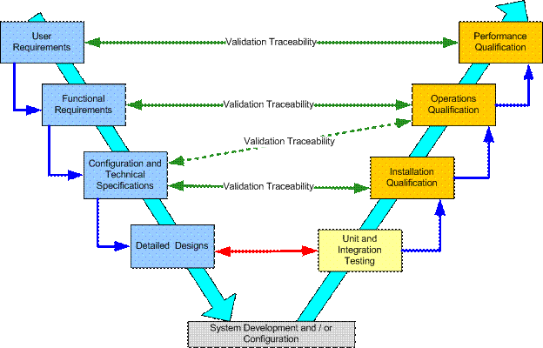
German V-Model
a linear lifecycle model
[German Ministry of the Interior, 1996]
[http://www.glemser.com/ images/misc/VModel.gif]

Slide 24
Waterfall: Evaluation
Strong points
staged development reflects engineering practice
encourages a discipline of abstract modelling, to break down complex systems into parts, views
good for project management, coordination, documentation
V-model matches each specification stage with a validation stage, reducing cost of faults discovered early
Weak points
linear process is inflexible – in practice, stages overlap
imposes early commitment to rigid requirements
difficult to deal with late changes – increasing costs
real systems evolve faster than one complete cycle

Slide 25
Rapid Prototyping
an iterative lifecycle model
Reasons to adopt
Requirements are vague or poorly understood
Build a prototype to help elicit requirements
Collect feedback
Software lifecycle
Build a basic prototype
Iterate the prototype, add or change features
When acceptable, discard and build finished system
Initial prototype
Improved versions
Build system

Slide 26
Evolutionary Prototyping
Reasons to adopt
Requirements are vague or misunderstood
Time constraints may force early termination
Software lifecycle
Build a basic prototype
Evolve the prototype towards finished system
Stop when the system is ready, or the time limit is exceeded
an iterative lifecycle model
Initial prototype
Improved versions
Final version

Slide 27
Prototyping: Evaluation
Strong points
Helpful when requirements are not understood
Flexible, for small-to-medium sized systems
Short turnaround, accommodates late changes
Prototype can be discarded, or evolve to final version
Weak points
Development process is not visible
Evolution creates poorly structured systems
Special tools, special techniques required
Cannot use with large-scale projects requiring coordination

Slide 28
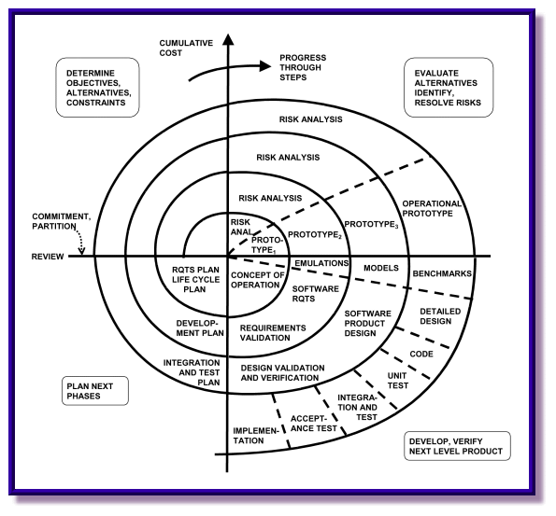
Spiral Lifecycle Model
an iterative lifecycle model
[Boehm, 1988]
[http://
www.stsc.hill.af.mil/
crossTalk/2001/05/
boehm.html]

Slide 29
Spiral Model: Features
Reasons to adopt
Key idea is risk evaluation and reduction
Each cycle is a stage in the software process (here, requirements, analysis, design, implementation)
Other stages possible (eg interface, database, middleware)
Can choose to terminate after each risk evaluation
Four stages
Set specific objectives for the current stage
Evaluate risks, explore alternative approaches
Develop and validate the current stage
Plan the next stage, when requested

Slide 30
Spiral Model: Evaluation
Strong points
Combination of waterfall and prototyping approaches
Adapts to different projects with different stages
Clear software process for large-scale projects, iterative cycles last 6 months – 2 years
Clear evaluation of each stage, determines whether to proceed, or cut losses due to high risk
Weak points
Projects can still be terminated before delivery
Late changes can still have serious consequences

Slide 31
Formal Systems Development
Reasons to adopt
Safety-critical, mission-critical systems
Medical treatment, aircraft, traffic control systems, etc.
Software lifecycle
Construct formal spec. from initial requirements
Prove safety properties of the specification
Use refinement rules to transform into a correct implementation
Initial requirements
Formal specification
proof
Transformations
refinement
Correct system

Slide 32
Formal Systems: Evaluation
Strong points
Precise and error-free: correct by construction
Used for safety-critical, mission-critical systems
Proofs of correct specification (complete, consistent)
Weak points
Requires specialised mathematical expertise
Perceived as difficult, or costly (but counter-examples)
Must still validate formal models against user requirements
Time-to-market is more compelling than correctness!
Non-formal approaches often seem adequate

Slide 33
Incremental Development
Reasons to adopt
Time-to-market is critical
Must deliver something
Software lifecycle
Sort requirements into prioritized increments
Deliver each increment within fixed time-box
Stop after the agreed number of iterations (often 4: DSDM)
an iterative lifecycle model
Prioritize requirements
Incremental version
increment n
Final version

Slide 34
Incremental: Evaluation
Strong points
Reduces gap between specification and delivery
Much lower risk of total project failure
Early increments can be prototypes
Highest priority services are delivered first
Weak points
Increments have to be small, to deliver within the time-boxed period (avoid “feature creep”)
Hard to map large global requirements onto increments
Short time-box (RAD, DSDM) works best when requirements are well-understood and modular

Slide 35
Lab 2: Which Lifecycle?
Run a Poll
Your client is a healthcare SME (small company)
want a ground-breaking software system to learn the links between disabilities and the kinds of equipment prescribed by doctors.
Your client is the Daimler AG automotive company
want to coordinate the release of their on-board engine monitoring system with matching engine maintenance systems at garages.
Your client is Boeing Commercial Airplanes
want the latest fly-by-wire and on-board entertainment systems for the next-generation Dreamliner airplane.
Your client is the UK National Health Service
want a standardised national healthcare record system, but don’t yet know how far the government budget will stretch.

Slide 36
Shift to Components
Bespoke structured systems
1970s: systems made-to-measure (at any cost!)
older structured languages: Fortran, Cobol
clear top-down design and stepwise refinement
Component-based systems
1990s: mix-and-match systems (fast, cheap)
object-oriented, component-based development
clear emphasis on component reuse
mixture of top-down design, bottom-up assembly

Slide 37
Component-Based Development
Requirements phase
Collect system requirements as a set of tasks (top-down), or user-interactions: use cases (bottom-up)
Analyse requirements to map onto software components
Construction phase
Build as much of the system as possible from existing components, or frameworks (component architectures)
Develop new components and integrate within existing framework
Reuse/refactoring phase
Schedule framework for maintenance (refactoring – improve structure) and harvest any new reusable components

Slide 38
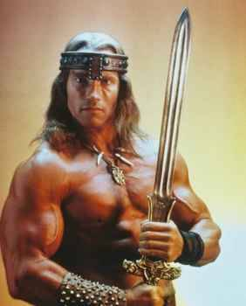
Changing Practices
Conan the
Librarian
How to reward developers?
KLOC? – promotes code bloat!
code reuse? – needs a proper market
elegance? – how to measure effectively?
New roles in software house?
developer – focus just on the application
facilitator – finds needed components in the library
scavenger – harvests components for the library
librarian – defends library from unguarded modifications
© Universal Pictures

Slide 39
Components: Evaluation
Strong points
Rapid development strategy, promotes reuse
Greatly reduced time-to-market (from 3rd project)
Reduces costs, and risks
Weak points
High initial set-up costs (building frameworks, components)
Retrain personnel to fit new roles (eg: librarian)
Can lose control over the component set (adaptation)
Systems are sometimes forced to fit the framework and so don’t deliver as expected

Slide 40
Agile Methods (XP)
Agile methods philosophy
No “big design up-front” – just “user stories”
The production code base and saved tests are the only lasting deliverables
Short increments, daily builds, pass all tests
XP has “pair programming”: coder and critic
Anyone can modify the code base (extreme!)
Embrace change (extreme!)
Examples
eXtreme Programming (XP) [Beck, 2000]
Scrum [Sutherland and Schwaber, 1996]

Slide 41
Agile Methods: Evaluation
Strong points
Avoids unproductive, wasted documentation
Emphasis on testing (= meeting specification)
Developers enjoy the lightweight approach
System is always up-to-date
Weak points
Inflexible process, cannot adapt to organisations
Expects good design to emerge by evolution
In practice, may fail for large systems that require coordination – no change tracking documentation

Slide 42
Shift to Services
Bespoke systems
1970s: large monolithic systems serving a single purpose, each a one-off design
Component-based systems
1990s: systems broken down into mix-and-match reusable components
affected creation, not deployment; software still sold as shrink-wrapped releases
Service-oriented systems
2000s: early web-wrappers for ERM software
2010s: components converted into service bundles, rented in the cloud
Enterprise Resource Management

Slide 43
Services – Evaluation
Strong points
Purchase only those services you need, rather than a whole shrink-wrapped package
No need to re-purchase the latest upgrades, since rented services are always up-to-date
Converts capital expenditure (CAPEX) into operating expenditure (OPEX)
Weak points
Web layer adds further complexity, many interfaces between service components
Additional Internet security issues, especially with JavaScript
Cloud platforms with large ecosystem of providers; very hard to assure quality control

Slide 44
Summary
Software engineering covers all aspects of software production: technical, management process
Software engineering includes software products, processes, models and people
The software lifecycle consists of: requirements elicitation, analysis, design, implementation, testing, maintenance…
Traditional process models are linear, good at coordinating large teams, but weak when handling change
Radical process models are iterative, good at adapting to change and delivering, but weak at coordination
The shift to software component technology requires a shift in the software development strategy

